Slide 1
RUNGTA COLLEGE OF DENTAL SCIENCES & RESEARCH
TITLE OF THE TOPIC - ISOLATION
DEPARTMENT OF CONSERVATIVE DENTISTRY AND ENDODONTICS

Slide 2
Specific learning Objectives
At the end of this presentation the learner is expected to know ;
Core areas* | Domain ** | Category #
Introduction | Cognitive | Must know
Method | Psychomotor | Must know
Armamentarium | Cognitive | Must know
*Subtopic of importance
** Cognitive, Psychomotor or Affective
# Must know , Nice to know & Desire to know
( Table to be prepared as per the above format )

Slide 3
Content
Introduction
Methods
Direct methods
Indirect methods
Rubber dam
Recent alternatives to rubber dam

Slide 4
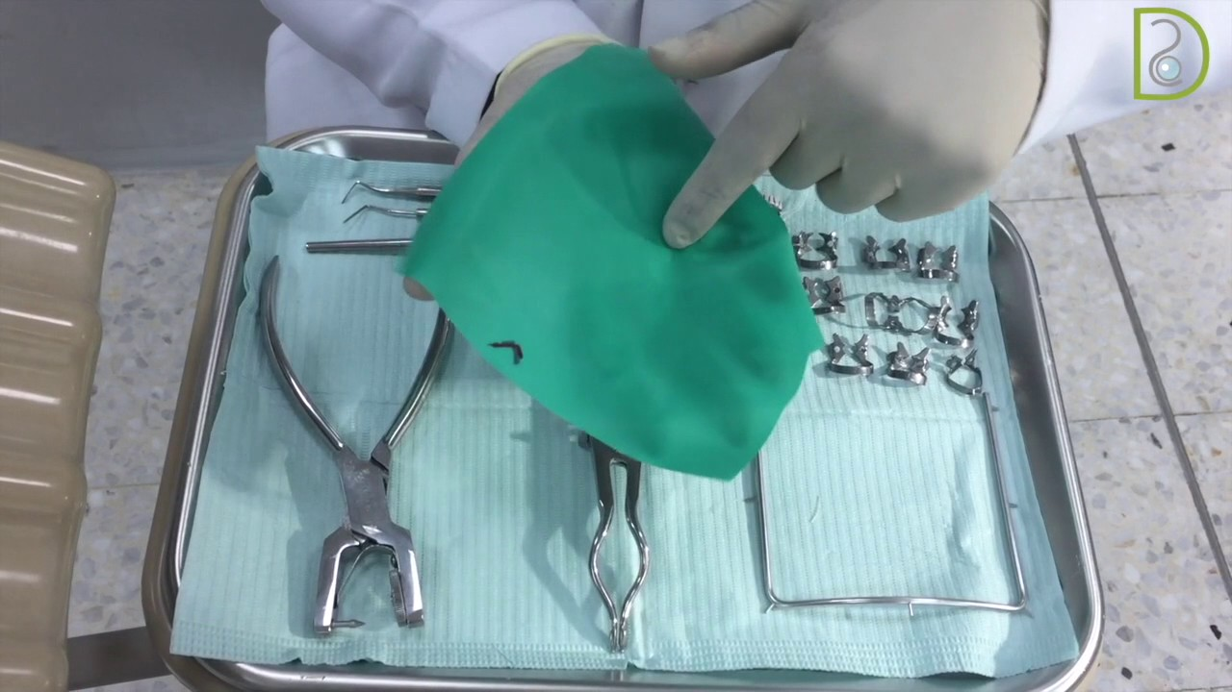
Rubber dam
Introduced by S.C Barnum in 1864.

Slide 5
Advantages
Provides a dry , clean operative field
Maximum access and visibility
Provide a good contrast to the operating site
Improved properties of dental materials
Protection of the patients
Protection of the dentist
Increase operating efficiency

Slide 6
Disadvantages
Patients objection
Time consumption

Slide 7
Indication
Endodontic procedures
Excavation of deep caries
Adhesive restorations
Bleaching
Subgingival restorations
High – risk patients

Slide 8
Contraindications
Teeth that have not erupted sufficiently to support a retainer
Some third molars
Extremely malpositioned teeth
Asthmatic patients with breathing problems
Patients with latex allergy

Slide 9
Armamentarium
Rubber dam sheet
Rubber dam template
Rubber dam punch
Rubber dam clamps
Rubber dam forceps
Rubber dam frame
Rubber dam lubricant
Rubber dam napkin
Dental floss

Slide 10
Rubber dam sheet
Available : latex or non latex
Size: 5”x 5” or 6”x 6’’
Grades of rubber dam material
Grades | thickness
Thin | 0.15mm
Medium | 0.20mm
Heavy | 0.25mm
Extra heavy | 0.30mm
Special heavy | 0.35mm

Slide 11
Available in light and dark color
Sheet has two surfaces dull and shiny side
Dull side is less reflective so placed facing the operator
In most procedures heavy thickness rubber dam sheet is used
When there is need for better gingival retraction extra heavy and special heavy dams are used
Thinner dams are used when contact are very tight
In case of allergy to latex rubber nitrile or vinyl rubber dam material are used

Slide 12
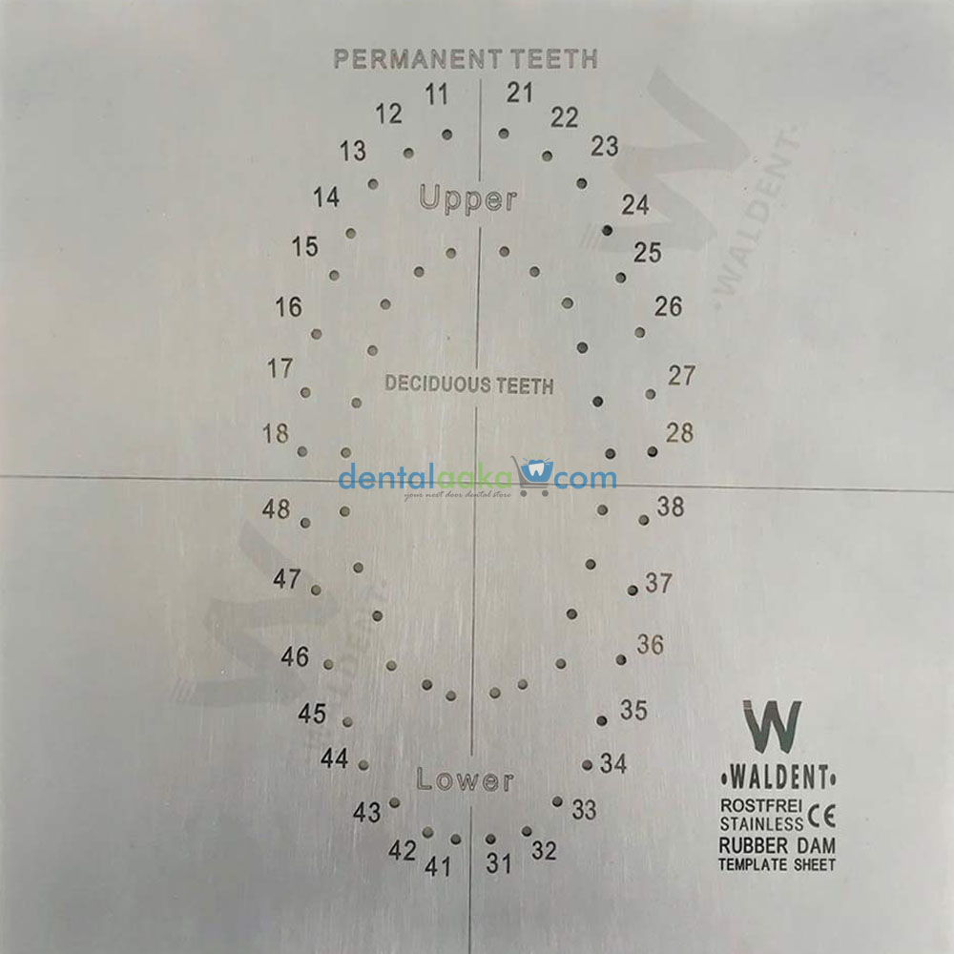
Rubber dam template
Have positions of the teeth marked on them and are used to transfer them to the rubber dam sheet for holes to be punched .

Slide 13
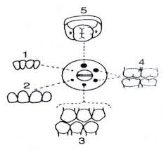
Rubber dam punch
Used to cut the holes in the rubber dam sheet will encompass the teeth to be isolated.
The larger holes – molars
Medium holes – premolars , upper cuspids and sometimes for upper incisors
Small holes – lower incisors

Slide 14
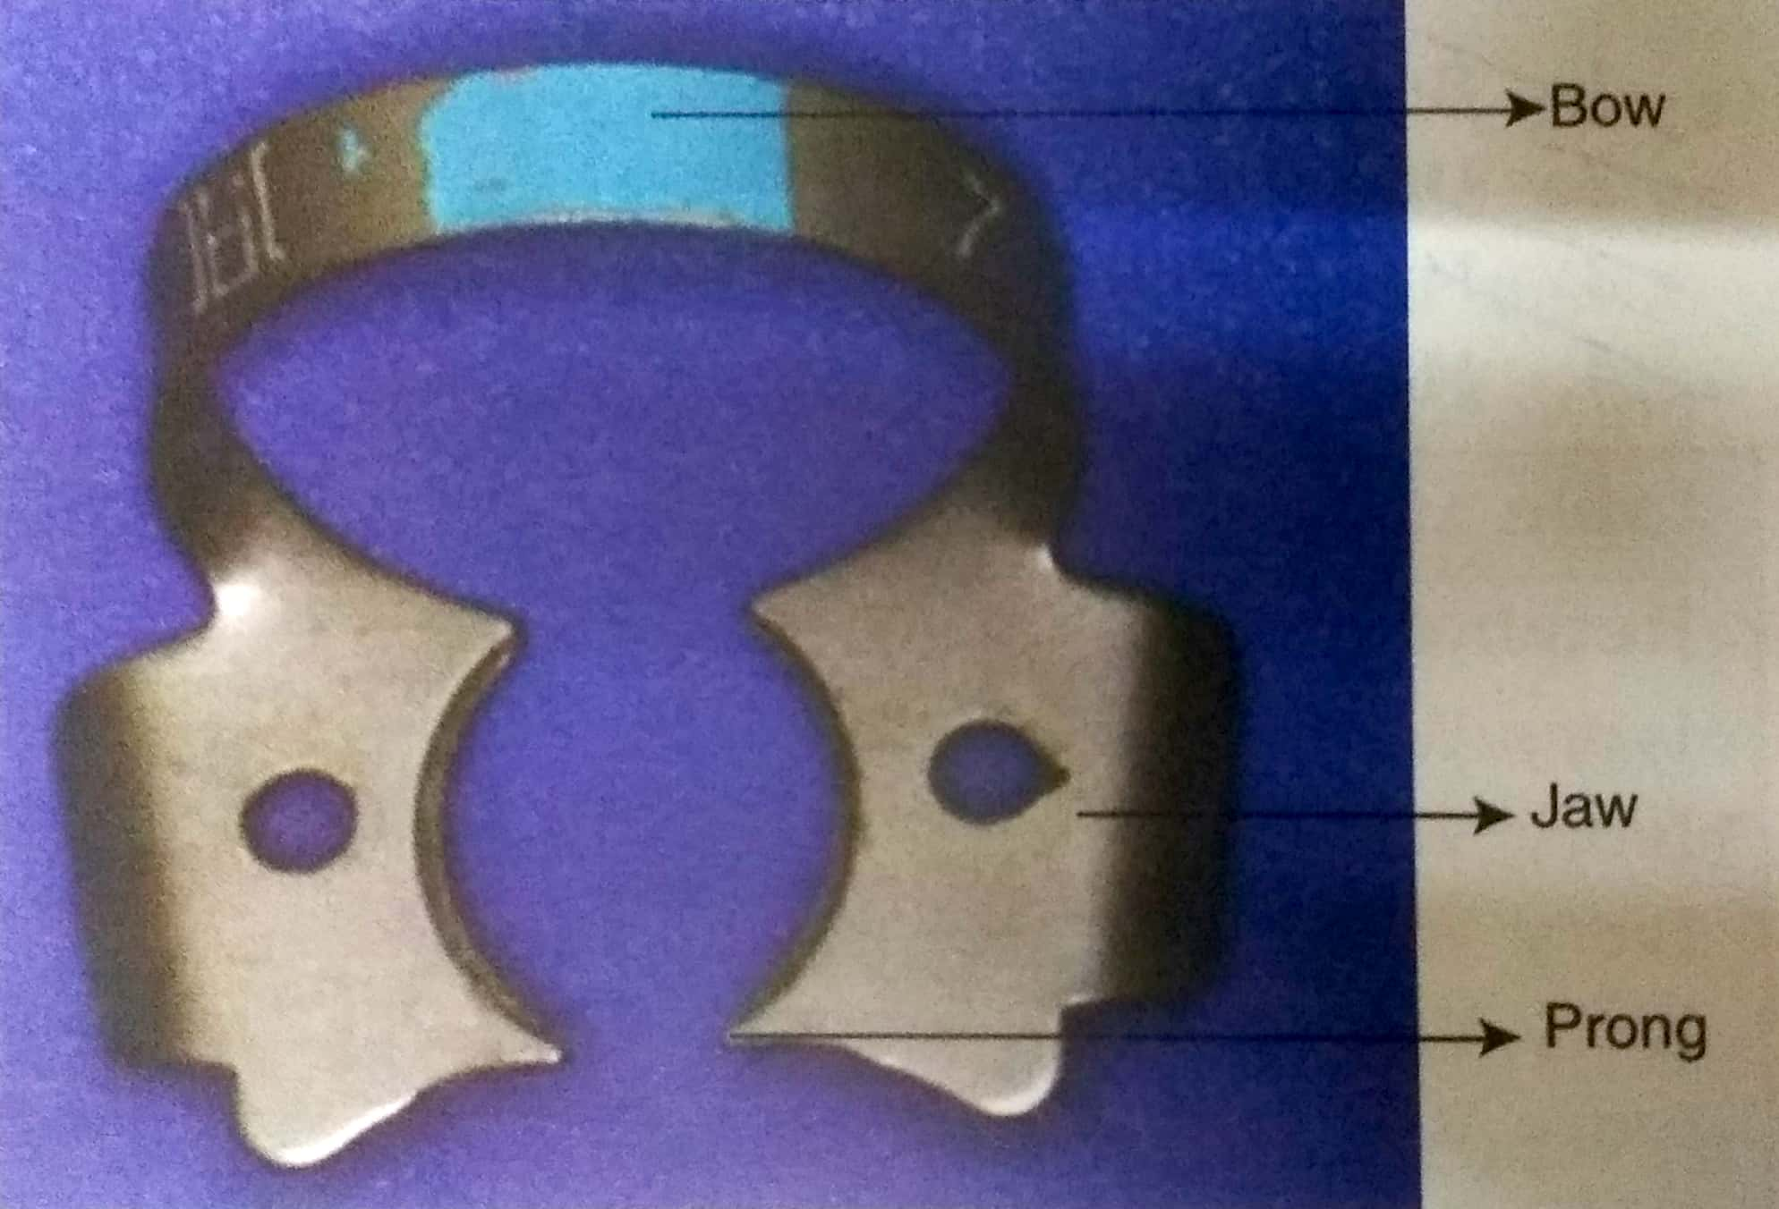
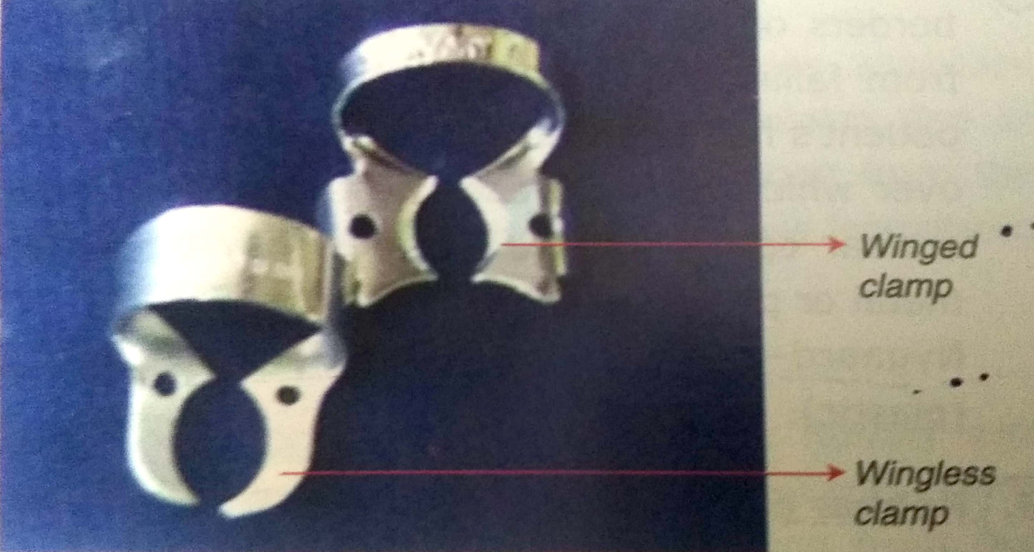
Rubber dam clamp
Parts of rubber dam clamps
Can be classified as wing clamp or wing less camp

Slide 15
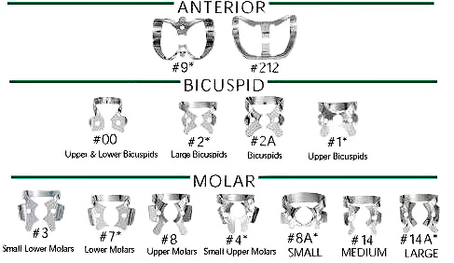
clamps used
FRONT TEETH:
IVORY.......# 6
IVORY.......# 9
IVORY.......# 90N
IVORY.......# 212S
IVORY.......# 15
PREMOLARS:
IVORY.......# 1
IVORY.......# 2
IVORY.......# 2A

Slide 16
MOLARS THAT ARE COMPLETELY ERUPTED, WHOLE, OR COVERED BY FULL CROWNS: IVORY.......# 7
MOLARS THAT ARE INCOMPLETELY ERUPTED OR ALREADY PREPARED FOR A FULL CROWN:
IVORY.......# 14
IVORY.......# 14A
IVORY.......# 7A
ASYMMETRICAL MOLARS, IN PARTICULAR THE SECOND AND THIRD:
IVORY.......# 10
IVORY.......# 11
IVORY.......# 12A
IVORY.......# 13A
WINGLESS, TO BE USED WHEN THE WINGS OBSTRUCT THE WORKING FIELD:
IVORY.......# W8A
IVORY.......# W26N

Slide 17
Rubber dam forceps
It is a modified forceps which retracts the jaws of a clamp away from each other
This allow the clamp to over come the occlusal diameter of the tooth and to be seated apical to the height of the axial contour
Clamp has holes or grooves in each of its jaws to accommodate this forceps

Slide 18
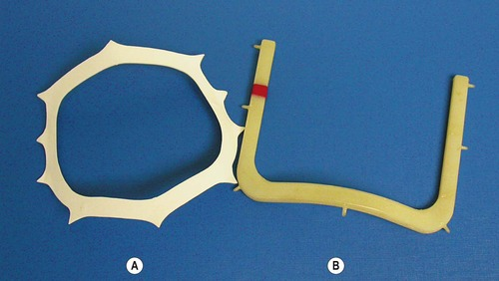
Rubber dam frame
Keep the peripheries of the dam sheet out of the mouth
Stretch the applied dam in four direction
To retract the tongue, cheek and lips and to clear the operation field .
DISADVANTAGE
Completely cover the patient’s nose and mouth, giving the patient unpleasant sensation of suffocation
Do not cause retraction of lips or cheeks
YOUNG’S FRAME
NYGAARD-OSTBY FRAME

Slide 19
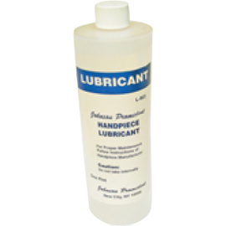
Rubber dam lubricant
Before positioning the dam, it is advisable to lubricate the inner surfaces well
Vaseline or liquid soap
The sheet will slide better over the contours of the teeth
more easily overcome the contact areas
close tightly around the cervix of the tooth.
Rubber dam lubricant

Slide 20
Rubber dam napkins
Rubber dam napkins
These prevent direct contact between the rubber sheet and the patient’s cheek.
Uses:
Absorbing the saliva that accumulates beneath the dam by capillary action.
Use is not mandatory but indicated in cases of allergy to the rubber dam sheet .

Slide 21
Dental floss
Dental floss
Use
preventing the ingestion or aspiration of the clamp
useful for assessing the condition of the mesial and distal contact areas

Slide 22
TAKE HOME MESSEGE/ FOR THE TOPIC COVERED (SUMMARY)
In dentistry, separation of a tooth or group of teeth from oral tissues and saliva by use of a dental dam, cotton rolls, or other means to improve access, visibility, and control moisture contamination while restorative or operative dental procedures are performed.

Slide 23
Question & Answer Session
1. write in detail about rubber dam isolation.
2. write short notes on
insta dam
optra gate

Slide 24
References
Operative Dentistry – modern theory and practice - M.A.Marzouk
Art and Science of operative dentistry. Seventh Edition – Sturdevant’s
Clinical operative Dentistry Principles and Practice . Second edition –Ramya Raghu
Author : I . A. Ahmad. Rubber dam usage for endodontic treatment : a review. International Endodontic journal 2009;42:963-972.
Author: Nidambur vasudev ballal, Deepika khandelwal and muliya vidya saraswathi . Rubber dam in endodontics- An overview of recent advances. International Journal of Clinical Dentistry.2018;6(4)320-30.

Slide 25
Suggested reading
Operative Dentistry – modern theory and practice - M.A.Marzouk
Art and Science of operative dentistry. Seventh Edition – Sturdevant’s

Slide 26
THANK YOU

